Slide 1



















Using Power BI by Jagmeet Singh

Slide 2



Introduction
In the dynamic world of music streaming, understanding trends is crucial for content creators. By leveraging Power BI, we dive into YouTube song data, uncover patterns, and optimize content strategies. Here’s how this analysis plays a pivotal role:
YouTube song analysis empowers creators to fine-tune their content strategy, engage viewers, and stay ahead in the ever-evolving music landscape. Let’s harmonize data and creativity!

Slide 3






Understanding the Dataset
The dataset for YouTube song analysis includes essential attributes like video ID, channel title, and engagement metrics (views, likes, comments) along with video details such as title, description, tags, and technical aspects like duration, quality, and captions. These elements are key to understanding viewer behavior and optimizing content for better performance and audience reach.The analysis aims to uncover trends, preferences, and patterns in the data to aid content creators and stakeholders in optimizing their YouTube song content.
www

Slide 4





Benefits of Song Analysis using Power BI
Insightful Trends:
Optimized Content:
Accurate targeting
Engagement Metrics
Data-Driven Decisions

Slide 5
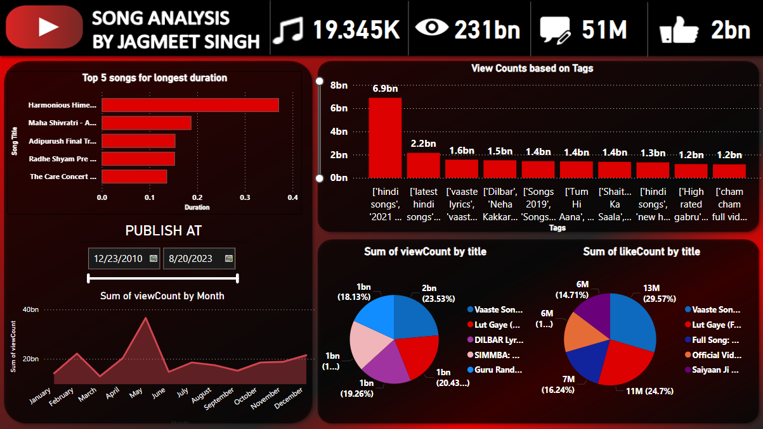
DASHBOARD

Slide 6

Key Findings
Top Duration: “Harmonious Himesh” has the highest duration among the top 5 songs.
Publish Date Range: Songs were published between December 23, 2010, and February 22, 2023.
Total Metrics: The Dataset has 19.345K total songs,
231 billion total views, 51 million total likes, and 2 billion total comments.
Tag-Based Views: The tag ‘hindi songs’ has the highest view count at approximately 7 billion.
View and Like Count by Title: “Vaasta song” dominates both the sum of view count and like count by title.
Views by Month : §The month of May has the most number of views of over 36Billion views
INCREASING VISIBILITY

Slide 7










